Slide 1
Common questions asked about RSE
Is Relationships and Sex Education (RSE) compulsory?
It’s compulsory for primary schools to teach Relationships Education and Health Education.
The Department for Education (DfE) also strongly encourage schools to teach Sex Education. Schools must consult parents in developing and reviewing their RSHE policy. Schools should ensure that the policy meets the needs of pupils and parents and reflects the community they serve.
Schools should provide examples of the resources that they plan to use. This can provide reassurance for parents and helps to continue the conversations started in class at home.
Where a primary school chooses to teach aspects of sex education (which go beyond the statutory National Curriculum for Science requirements), the school must set this out in their policy and all schools should consult with parents on what is to be covered. Primary schools that choose to teach non–statutory sex education must allow parents a right to withdraw their children.

Slide 2
Does SCARF cover non-statutory Sex Education?
There is very little in the SCARF programme that is non-statutory. We interpret sex education to mean puberty, conception, reproduction and birth. All of these themes, with the exception of conception, are statutory and included in either Health Education or National Curriculum Science.
The statutory guidance states that sex education should ensure children know how a baby is conceived. We interpret 'how a baby is conceived' as referring to what happens during sexual intercourse before an egg and sperm meet (reproduction). We therefore include sexual intercourse as well as IVF in our Year 6 Making Babies lesson.
SCARF is a spiral curriculum and so previous lessons would have covered hygiene, bacteria and the importance of hand washing, this naturally leads on to discussions about different viruses, of which HIV is important to understand.
The purpose of this particular SCARF lesson is to raise awareness and reduce stigma and misconceptions surrounding HIV.
The statutory guidance aims to provide a balance between what must be taught by the end of Year 6, alongside decisions about how and when the school delivers the content. Parent consultation helps each school to strike a balance that’s appropriate to the needs of its children.

Slide 3
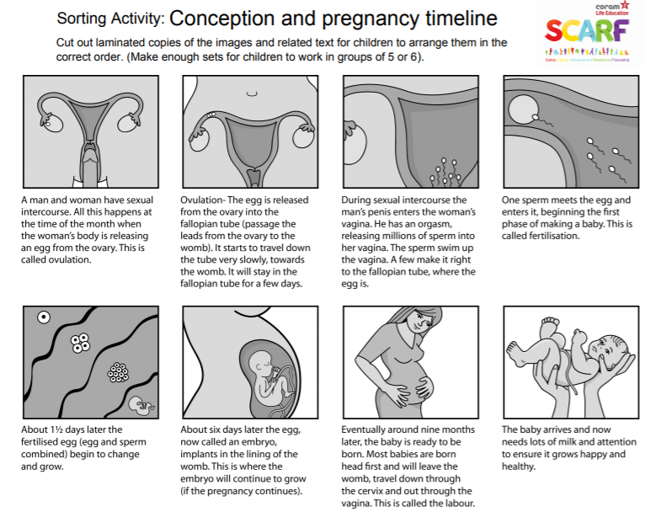
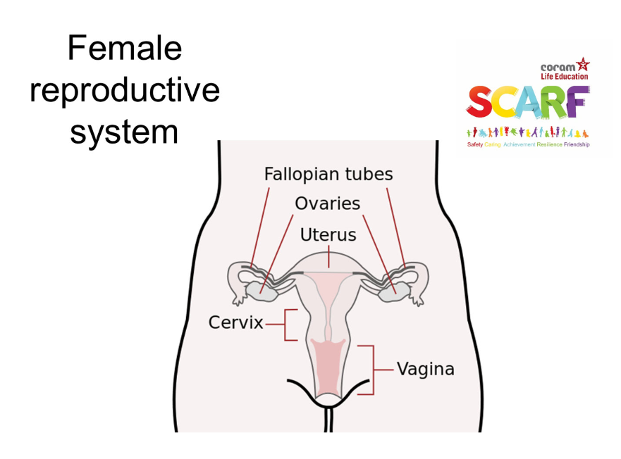
Does SCARF cover non-statutory Sex Education?
The Making Babies Lesson is the only non-statutory lesson that SCARF provide. Below is an example from the lesson (bottom right). This lesson builds on the knowledge they learn in Year 4 and 5 when they are taught about puberty, menstruation and how body shapes begins to change (science curriculum).
The lessons are delivered by confident teachers at school in a respectful mature and safe environment and maybe delivered in single sex sessions. This helps educate children with the correct scientific terms and challenges any misinformation they may have found online.
Year 5
Changes to the adolescent body ‘Puberty’
This is in the Science curriculum for Year 5.
This area of learning will begin in Year 4 to reflect the needs of the children in school.
Year 6
The learning builds from ‘Puberty’ and the adolescent body to conception in Year 6.

Slide 4
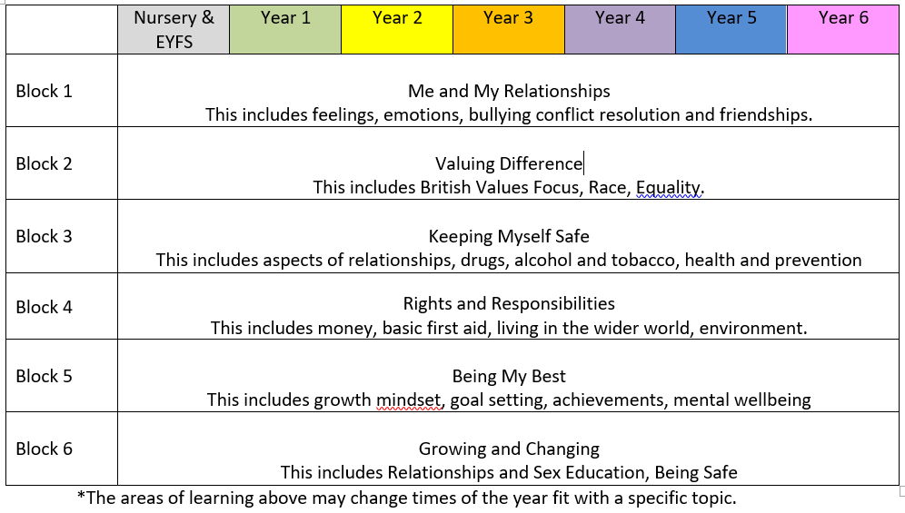
When will my child’s school be delivering Relationships and Sex Education?

Slide 5
How do I withdraw my child?
If you wish to withdraw your child from the “Making Babies” lesson in year 6 you can request to do this by contacting the office via email. Please tell us why you wish to withdraw your child as we maybe able to provide you with additional information to help reassure you.
If your child is withdrawn from this lesson then additional work will be provide that follows the curriculum being taught at the time.

Slide 6
When will my child’s school be delivering Relationships and Sex Education?
This is our consultation process:
If you have any further questions then you can complete a feedback form online found on the school website under the top banner of News and then RSHE.
This policy will also be available for governors, staff and children to consult on. This will shape a well rounded policy and curriculum for Glapton.
Your Deadline to consult on will be March 19th 2021.

Slide 7
What can I do to support my child’s learning at home?
The statutory guidance is clear in recognising that a parent/carer is a child’s primary educator in these matters. There are a many things you can do to support your child’s understanding and encourage them to ask questions. Here are some:
If you feel it is time to talk to your child about growing up and the changes they are likely to experience it’s best to offer it in small chunks, rather than do it in one go, often known as ‘The Talk’. This gives children time to digest the new information and ask you further questions as they develop more understanding.
If your child asks you questions try to stay calm, and not worry if you don’t know the answer. There are plenty of websites that you can use together to help you find the answers to their questions in a factual, honest, age appropriate way (see details below for resources on our website).
Use everyday opportunities to bring up the topic; things you see on TV or hear on the radio can be great conversation starters to talk about topics such as relationships, sex and body image. Reading books with your child is also a great way of introducing topics and helping children to understand themselves, their bodies and the world around them.
If you do have family names for genitals, ensure your child also knows their scientific names too. Nobody likes to think their child is at risk of abuse, but knowing the correct words for their genitals will help them report abuse if it did ever happen.
By showing your child that you are comfortable with them asking you questions now, you are helping to develop a relationship with them where they can seek your advice and support in their adolescent years.

Slide 8
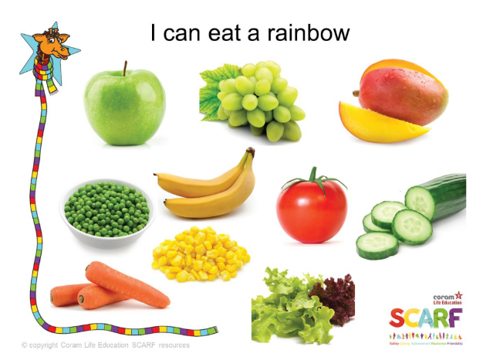
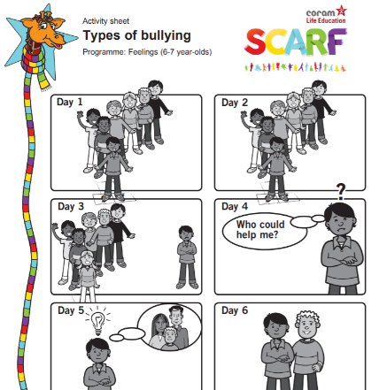
Year 2
A bullying cartoon that explores what to do when you think you are being bullied.
Other Resource Examples:
“I can eat a Rainbow” Lesson from Year 1. Healthy Eating.

Slide 9
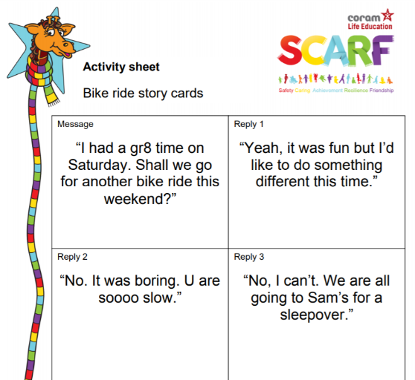
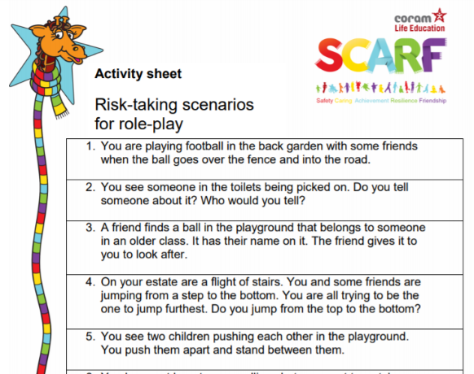
Year 3
Risk or Danger!
This helps the children what is a risk and what is a danger and how to deal with these scenarios.
Year 4
Ok and Not Ok!
Relationships and the way we talk to each other.
Other Resource Examples:

Slide 10
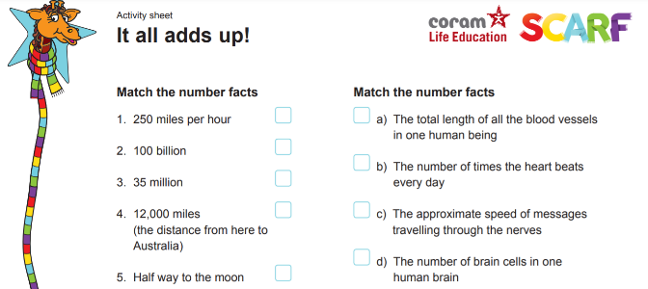
Year 6
Challenging gender stereotypes through storytelling.
Other Resource Examples:
Year 5
“It all adds up!”
This lesson builds from getting fit and healthy lifestyles.

Slide 11
Thank You!
Consultation March 2021

